Slide 1


Department of Electronics and Communication Engineering
“IoT-Based Intelligent System for Real-time Monitoring of Animal Health and Geolocation for Enhanced Surveillance and Farm Management”
Presented by :
G. Sharanya (21271A0442)
V. Sai Koushik (21271A0435)
P. Sumanth (21271A0454)
N. Mahesh (21271A0420)

Slide 2
Table of Contents:
01
Abstract
07
Components
02
Introduction
Proposed Block Diagram & Circuit Diagram
08
03
Scope and Motivation
10
Prototype Model
04
Problem Statement and Objectives
11
Result Analysis
05
Existing System
12
Conclusion & Future Scope
06
Proposed Method
13
References

Slide 3
Abstract:
Develop a real-time, IoT-based health monitoring system for livestock and pets.
Utilizes sensors (e.g., temperature, heart rate, GSR, Accelerometer) mounted on the animal's body to monitor vital signs.
Implements various sensors, including GPS and BME680, to track the animal's location and monitor the environmental factors in their vicinity
Collected data is transmitted wirelessly to a centralized platform (ThingSpeak)
Early detection of anomalies enables timely intervention, reducing risks of disease or mortality.

Slide 4
Introduction:
Animal health is crucial for economic stability, food safety, and welfare in agriculture and domestic life.
Advances in sensor technology and IoT have created opportunities for real-time monitoring, allowing for continuous data access and management.
The expected outcomes include enhanced early detection of health abnormalities and improved health management practices, contributing to sustainable farming and better animal care.
Potential to integrate more advanced health metrics and AI-based predictive analytics for further health insights.

Slide 5
Scope and Motivation :
The scope of this project extends to three key areas—pets, livestock, and wildlife.
Early detection of health issues allows for timely interventions, reducing animal suffering and mortality.
This system helps farmers improve the efficiency of livestock management, reducing losses from disease, and improving the overall quality of livestock.
This project aims to contribute to conservation efforts by providing real-time data that helps protect endangered species, prevent wildlife deaths, and track their health.

Slide 6




Problem Statement :
Aim and Objectives :
Continuous monitoring is essential for increasing livestock productivity, but farmers face challenges due to labor shortages, lack of technical skills, and delayed veterinary care. Additionally, monitoring wild animals and ensuring timely intervention for their health is difficult, impacting both livestock management and conservation efforts.
Real-time and continuous monitoring.
Early detection of health problems
Proactive healthcare interventions
Cloud-based data processing and analysis

Slide 7
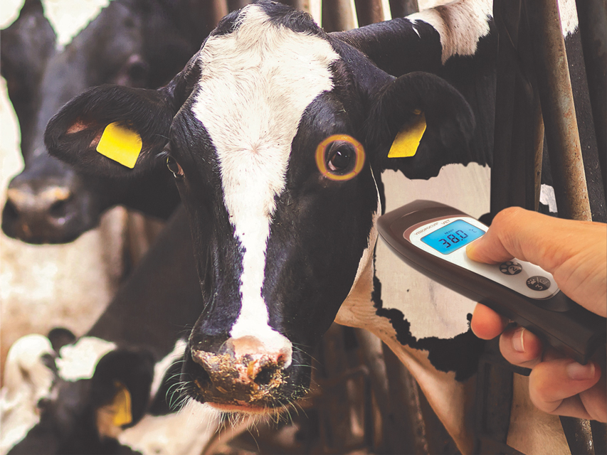
Existing System :
Relies on manual visual observation and periodic veterinary checkups.
Lack of integration between tracking and health monitoring systems.
Use of RFID tags and standalone GPS devices for location tracking.
Existing systems lack the capability
to monitor comprehensive health
parameters like activity levels &
stress.

Slide 8

Proposed Method:
We propose a smart animal health monitoring system aimed at improving animal health and well-being.
A GPS module is integrated to track the animal’s real-time location.
We are incorporating advanced sensors for more comprehensive health monitoring:
Galvanic Skin Response (GSR).
BME680 Sensor

Slide 9


Components :
Software components:
1. Arduino IDE :
The Arduino IDE (Integrated Development Environment) is a software platform used to write, compile, and upload code to Arduino boards and other compatible microcontroller platforms.
2. ThingSpeak:
ThingSpeak allows you to aggregate, visualize, and analyze live data streams in the cloud. It provides instant visualizations of data posted by your devices or equipment.

Slide 10
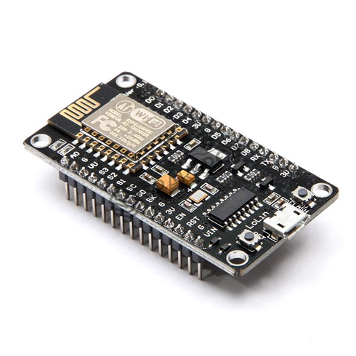
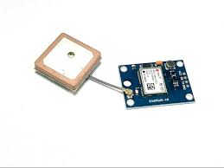
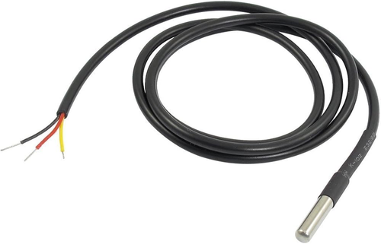
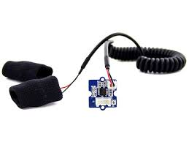
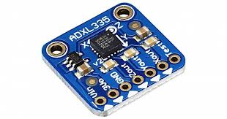
Hardware components :
NodeMCU ESP32
DS18B20 Temperature Sensor
MAX30100 Heart Rate Sensor
ADXL335 Accelerometer Sensor
GPS Neo 6M
Galvanic Skin Response (GSR) Sensor
BME680 Sensor
Bread Board
Battery

Slide 11
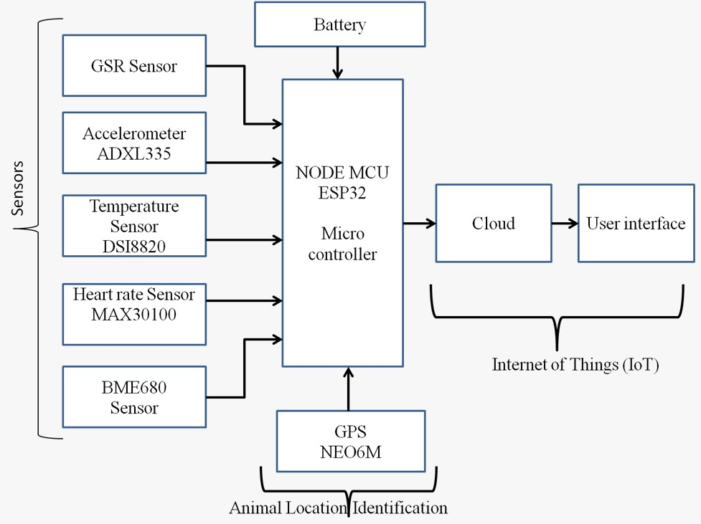
Proposed Block Diagram:

Slide 12
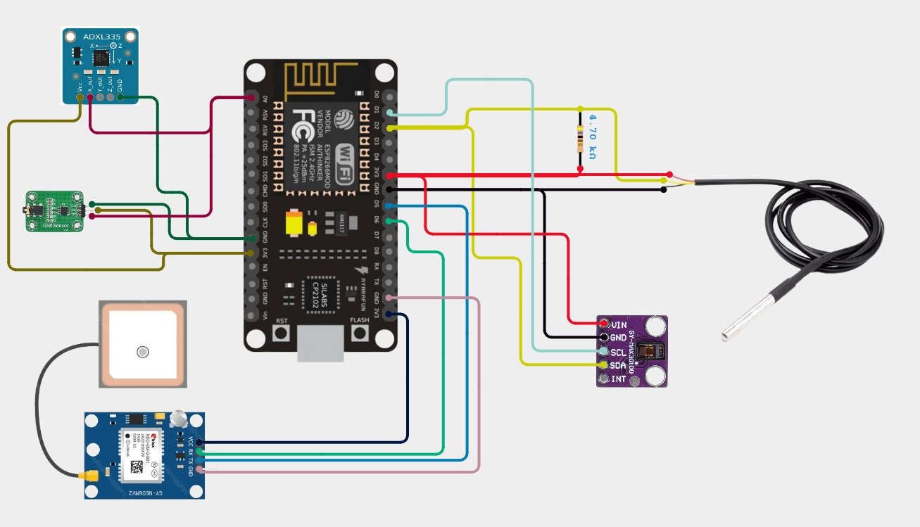
Circuit Diagram:

Slide 13
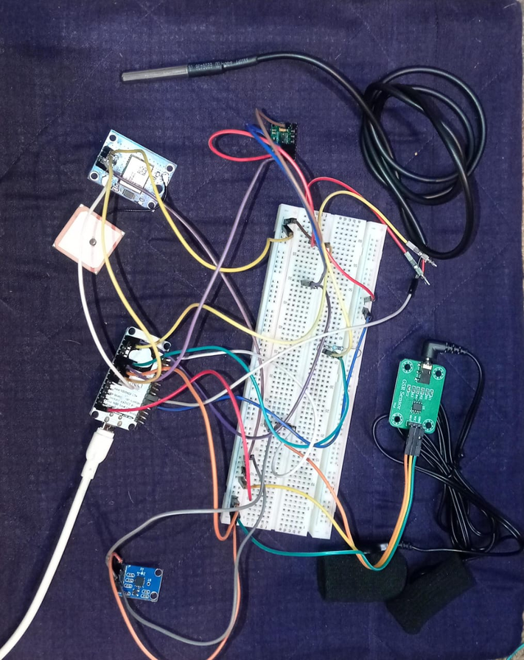
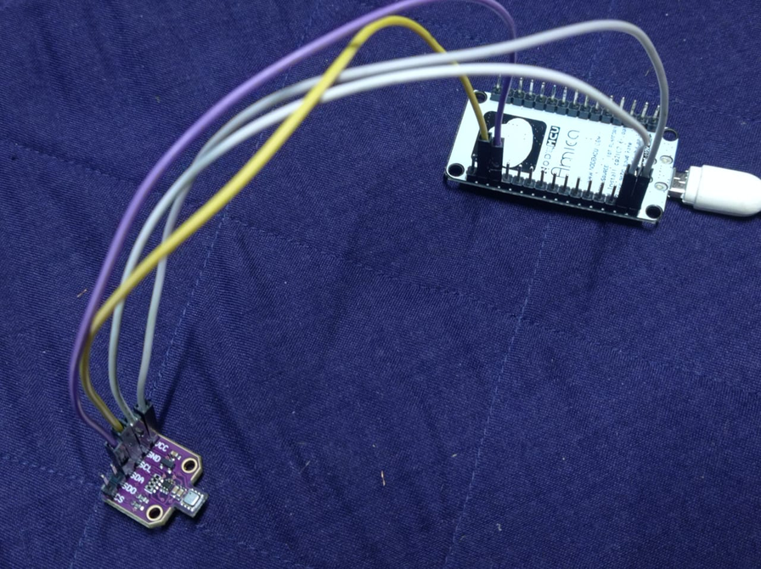
Prototype Model :
Sensors Integrated with Node MCU
BME680 Integrated with Node MCU

Slide 14
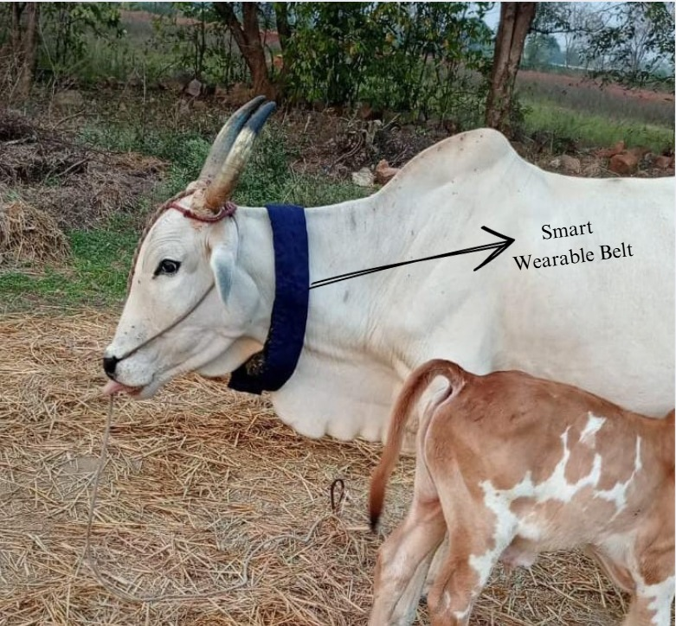
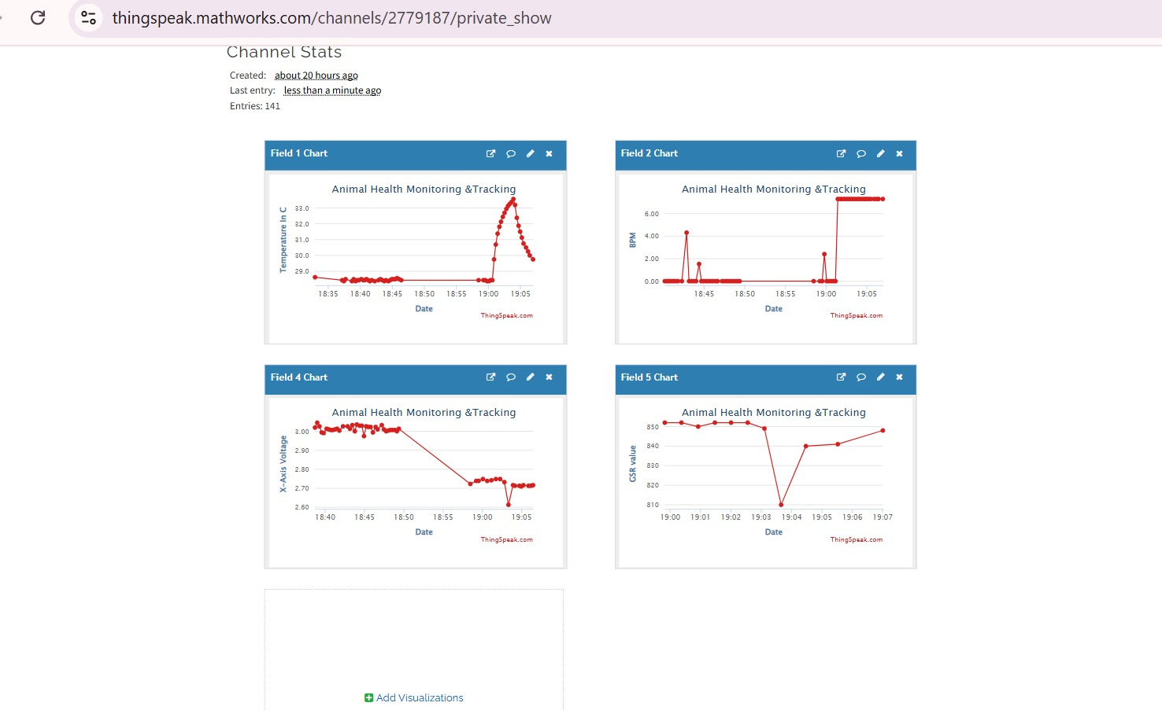
Result Analysis :
Cow with Monitoring Belt
Real-time monitoring of health parameters
using ThingSpeak.

Slide 15
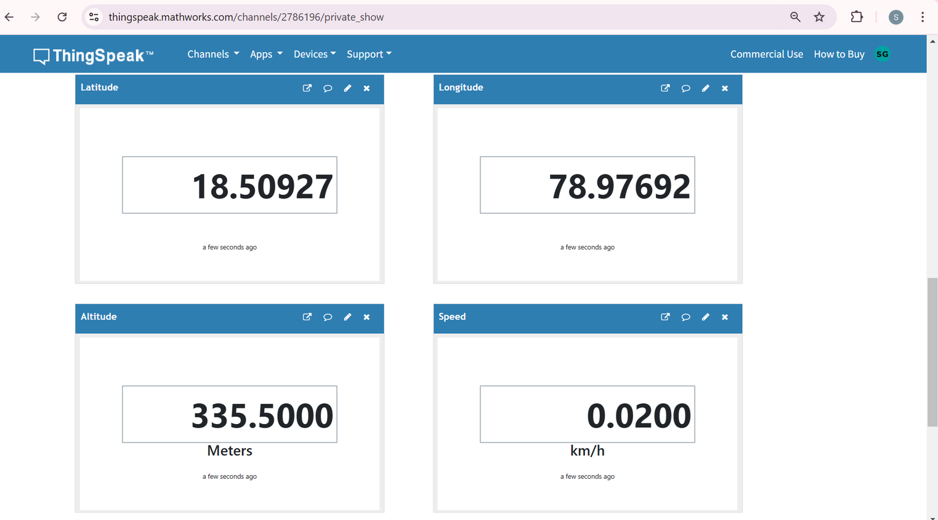
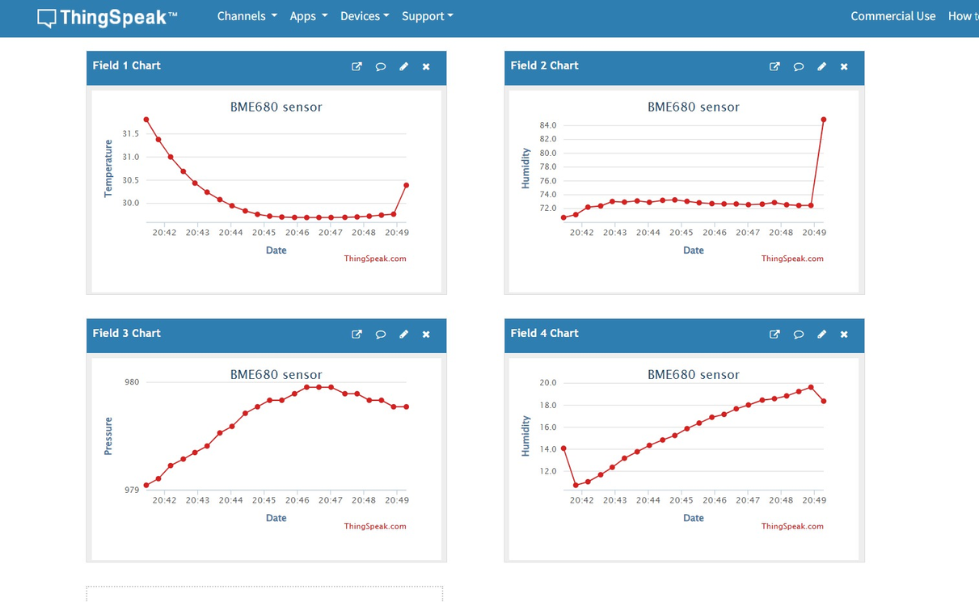
Tracking and Monitoring GPS Location
in Real-Time using ThingSpeak
Monitoring Environmental Parameters
using ThingSpeak.

Slide 16
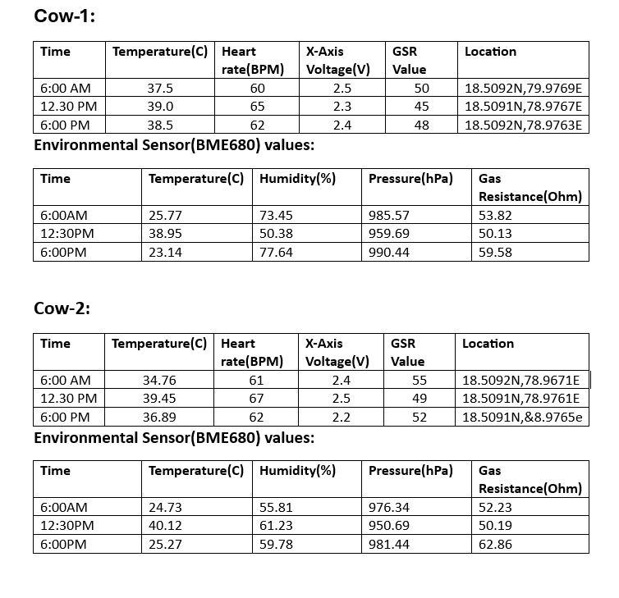

Slide 17
Conclusion :
IoT-based animal health monitoring and tracking systems revolutionize livestock management by enabling real-time monitoring, early disease detection, and precise tracking. These systems enhance productivity, reduce losses, and promote animal welfare, making them vital for modern agriculture. Integrating IoT with advanced analytics and wireless technologies ensures efficient and sustainable livestock management.

Slide 18
Future Scope :
By integrating Artificial Intelligence (AI) and Machine Learning (ML), the system can predict disease outbreaks and provide personalized health recommendations. It can also be adapted for use with other species, such as poultry, swine, or aquaculture, to enhance their health and welfare. The wearable devices could be vulnerable to theft, a smart theft detection system or burglar alarm could be integrated into the hardware to alert users and send notifications if the device is tampered with. This advancement could revolutionize the livestock industry, making it more efficient, secure, and data-driven.

Slide 19
References:
https://www.researchgate.net/publication/376558811_GSM-GPS Based_Animal_Tracking_System_Improving_Wildlife_Monitoring_Efforts
https://www.e3sconferences.org/articles/e3sconf/pdf/2024/37/e3sconf_icftest2024_01041.pdf
https://www.researchgate.net/publication/325635623_Animal_monitoring_based_on_IoT_technologies
https://www.ncbi.nlm.nih.gov/pmc/articles/PMC4880690/

Slide 20
Thank You !

